Slide 1
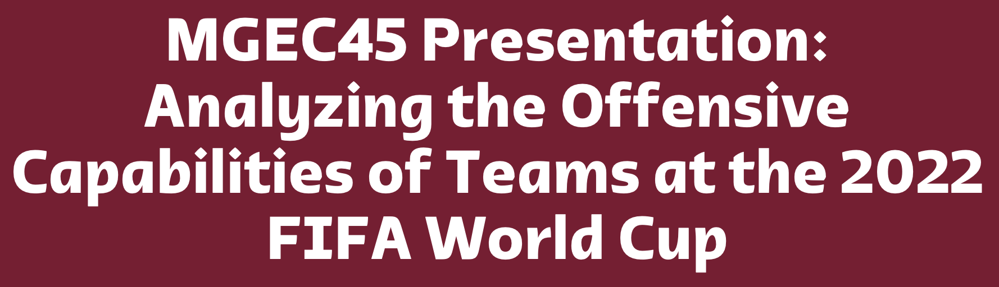

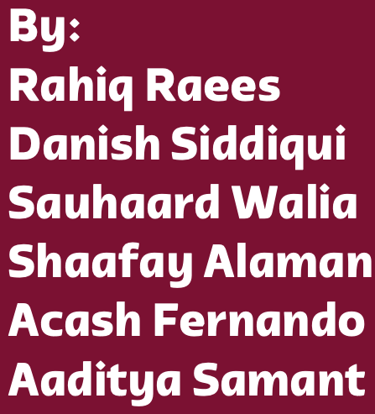
Qatar, location of 2022 World Cup

Slide 2
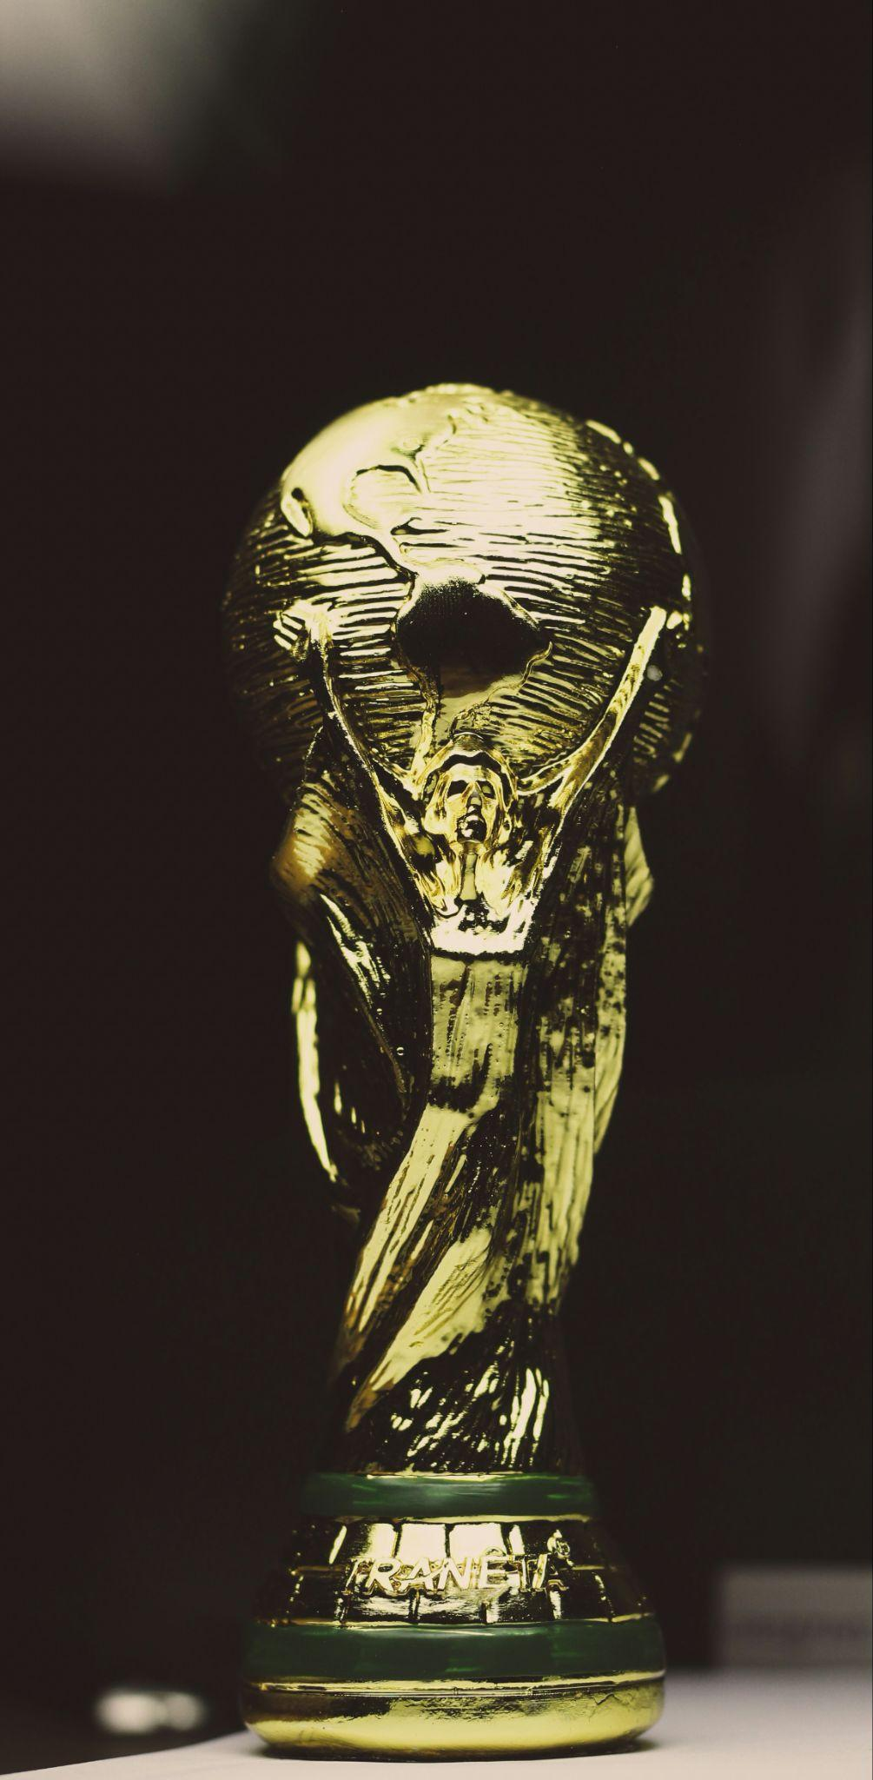
Table of Contents
Introduction
Research Question
Dataset
Expected Goals
Expected Goals Assisted
Expected Successful Passes
Conclusion

Slide 3

World Cup Winners
The FIFA World cup is the largest sporting event that occurs in the world, and has been running for over ninety years.
Introduction
It is held every four years, where 32 men’s senior national teams compete. Following a qualification stage, the tournament starts with a group stage. Each group contains four teams. The tournament moves forward until an ultimate winner is decided at the finals.
Brazil is the most successful team, with five wins!

Slide 4
"How did the predicted offensive capabilities of teams at the 2022 FIFA World Cup correspond with their actual offensive prowess?"
Research Question
Notes:
Our research question is important for the following reasons:
Strategic Analysis: Analyzing these key determinants can inform a teams strategic decisions. For example, a manager will definitely want to replace inefficient forwards that have an expected goal tally that far exceeds their total goal tally. The same can be said for midfielders as their primary role is passing which is arguably the most important aspect of the sport.
Performance Analysis: Answering our research question aids in evaluating the effectiveness of offensive strategies used by teams during high-stakes tournaments like the FIFA World Cup. Since the tournament was in 2022, we already know which teams were successful. Thus, we can determine if expected successful passes, xA’s and xAG’s is enough to predict the winners, or does defense play a large enough role to combat this.

Slide 5
We used a dataset from StatsBomb, a company that provides proprietary statistics for a number of sports out there.
We made use of event level data for the 2022 World Cup.
Utilizing library(StatsBombR) - the company’s own package - we could seamlessly stream required data into R.
Dataset

Slide 6
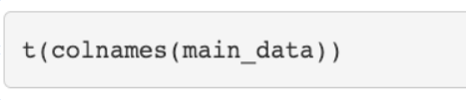
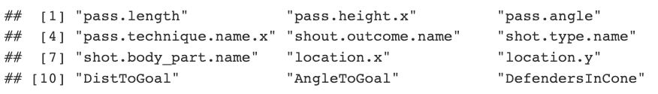
The dataset contains numerous variables concerned with passing and shooting
These variables allows us to apply logistic regressions in order to determine expected successful passes, xAGs, and xGs
Dataset

Slide 7
What’s the point of using expected goals when we have data on total goals?
Expected Goals
Notes:
To see how clinical a team actually is in front of goal, it is important to look at expected goals. For example, France was the top scorer with 16 goals, but if their expected goals was 22, we would say France does not capitalize on their chances. We would say a team excels at finishing if their actual total goals is significantly more than their expected.

Slide 8
The variables we thought were important to include in our xG regression:
shout.outcome.name: Dummy for goal/no goal
shot.type.name: open play, free kick, or penalty
shot.body_part.name: left foot, right foot, other
location.x & location.y
DistToGoal & AngleToGoal
DefendersInCone: Number of Defenders within Angle triangle.
Expected Goals

Slide 9
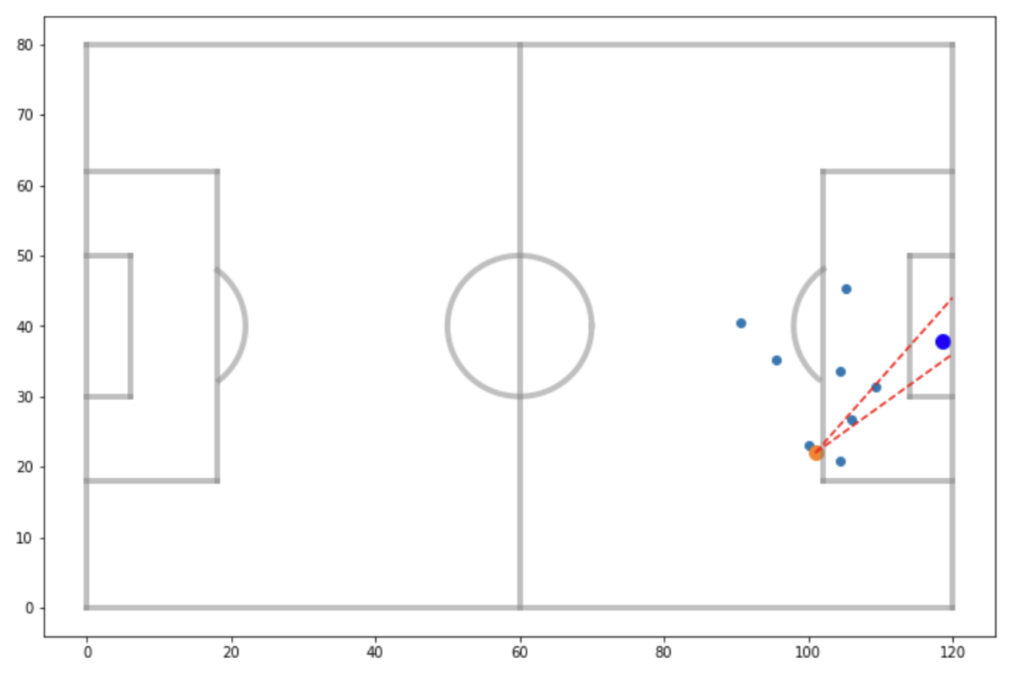
Expected Goals

Slide 10
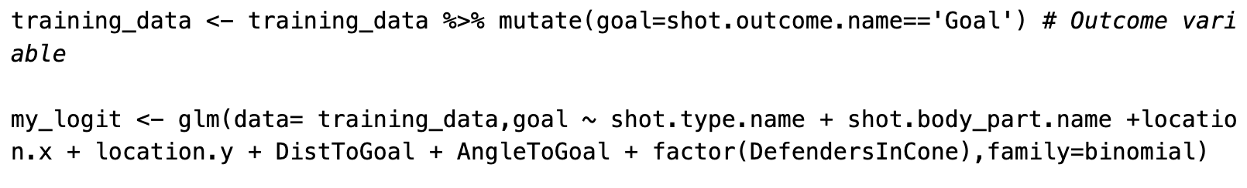
Only 195 goals were scored in our tournament, which we thought was insufficient in training an accurate model
195 goals would not represent all varieties of angles, distances, and/or defensive pressures when a shot is attempted
We used an independent dataset, namely the 2015/2016 Premier League season where the total goals scored were 988
Expected Goals
Notes:
We see that only 195 goals were scored in the tournament which we thought was insufficient in training an accurate logistic regression model.
195 goals would not would not completely represent all sorts of different angles, distances, and/or defensive pressures when a shot is attempted.
Thus, we used an independent training dataset, namely the 2015/2016 Premier League season that has data on all 380 matches played. T
he total goals scored in this season is 988. This new dataset is from the same source, and so it has the same variables as our World Cup dataset.

Slide 11
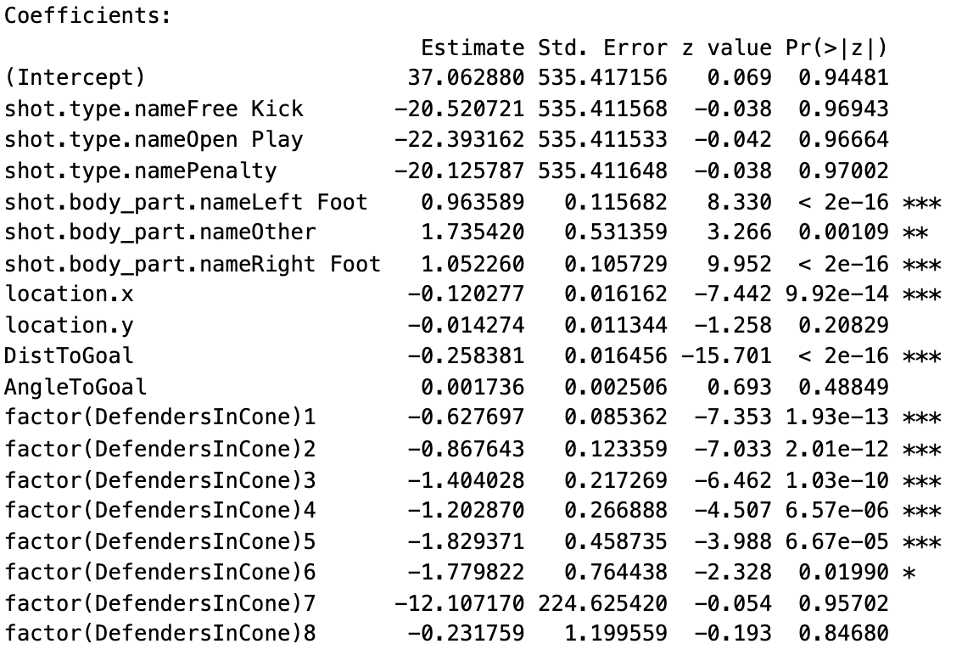
Expected Goals
Notes:
We determine the significant predictors by observing their p-values.
shot.body_part.name is a significant predictor. This makes sense since the chance of scoring a goal should depend on how you struck the ball (head,left/right foot).
Not surprising, DistToGoal and location.x are significant predictors since the further you are from goal, the harder it is to score. Surprisingly, location.y and AngleToGoal are not significant predictors. It is also surprising that shot.type.name(Free Kick,Open Play,Penalty) are not significant predictors. For example, we would have expected a penalty chance to greatly increase the chance of scoring.
DefendersInCone are significant predictors for the most part. This makes sense since the amount of defensive pressure should greatly impact scoring chances.

Slide 12
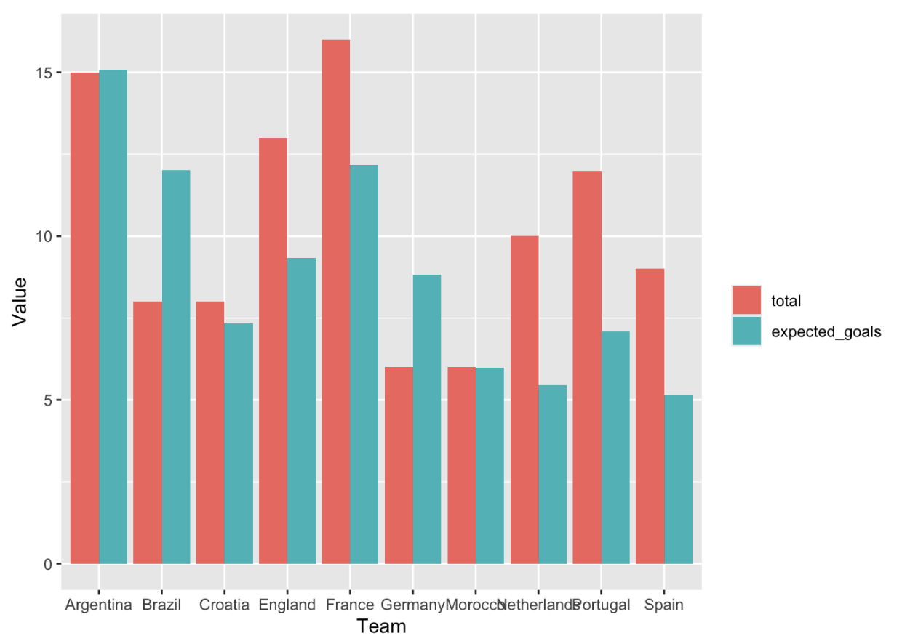
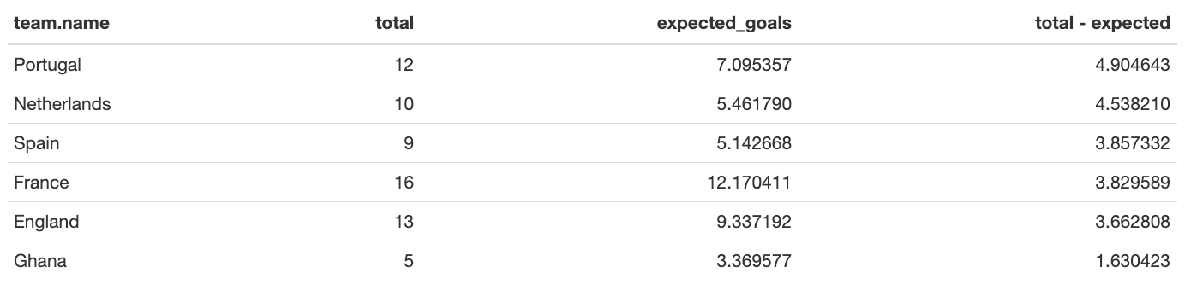
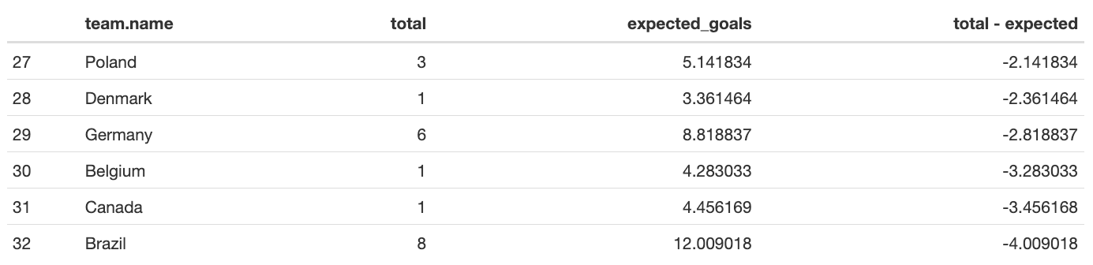
Expected Goals
Notes:
Portugal and Netherlands overperformed by the most. They scored a much higher number of goals than our model predicted. See: angle and distance of Portugal’s goals. These are goals that are NOT expected to go in.
Brazil and Canada were the largest underperformers. This could be due to the fact that they created a lot of opportunities, but failed to capitalize.

Slide 13
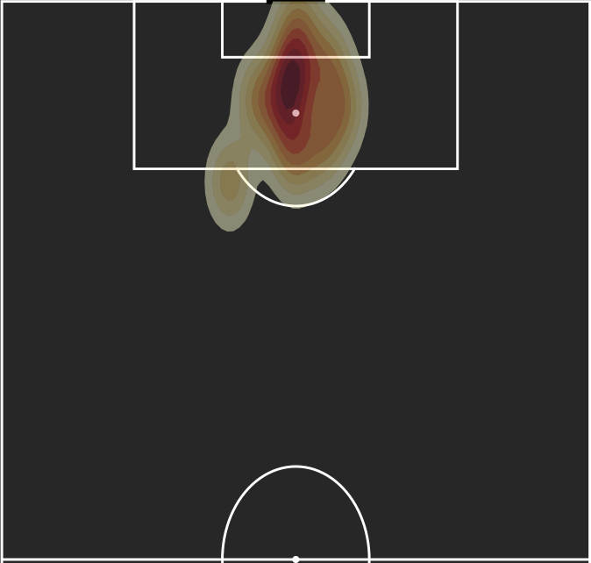
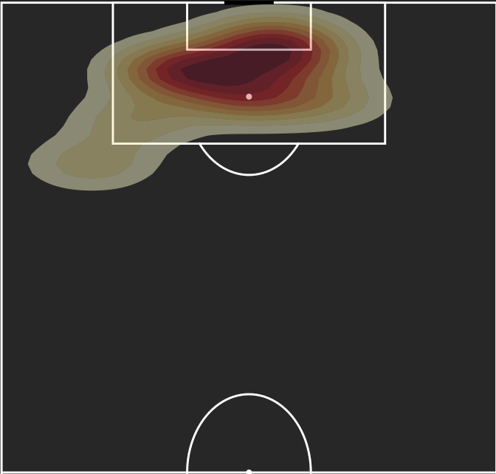
Netherlands -
Total Goals = 10
xG = 5.46
Overperformed by 4.54 goals
Top Overpeformer: Portugal -
Total Goals = 12
xG = 7.1
Overperformed by 4.9 goals
xG Top Overperformers: Portugal & Netherlands

Slide 14
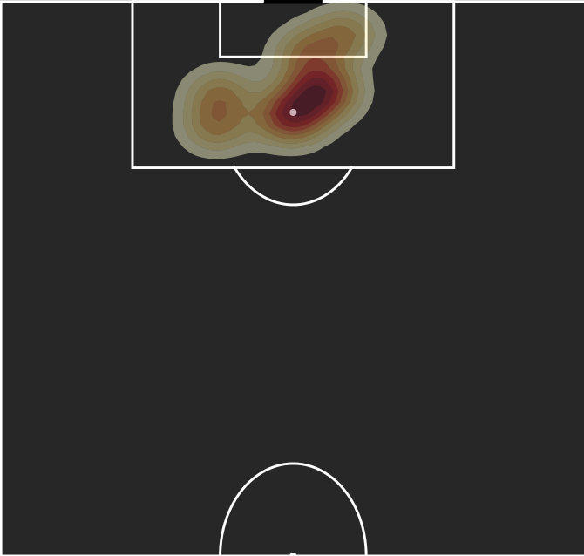
Brazil’s underperformance can be chalked down to them being absolute favourites and injuries. They were loaded with elite strikers such as Vini & Neymar Jr. Not only did they fail to capitalize on chances, but faced a pivotal injury.
Top Underperformer:
Brazil -
Total Goals = 8
xG = 12.01
Underperformed by 4.01 goals
xG Top Underperformers: Brazil

Slide 15
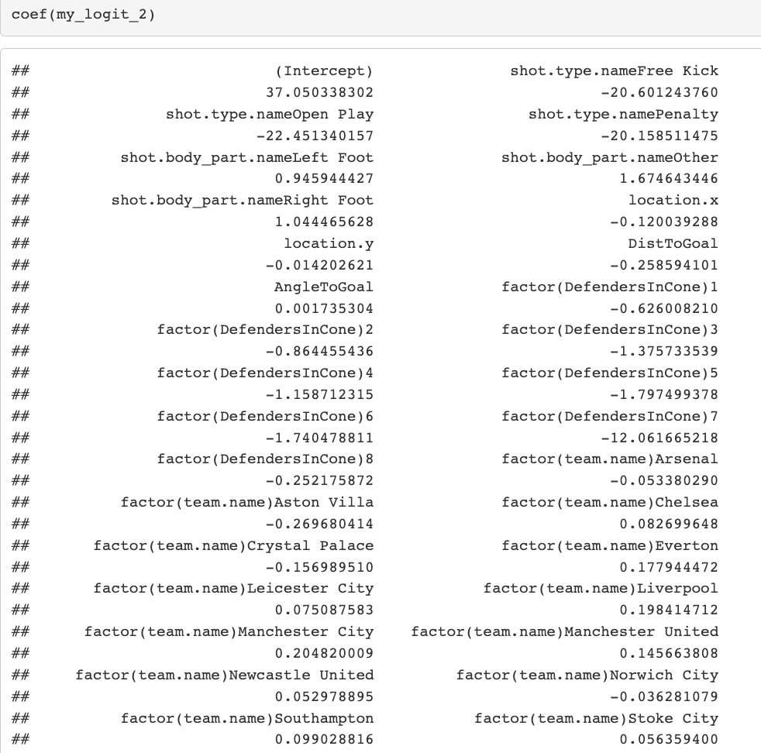
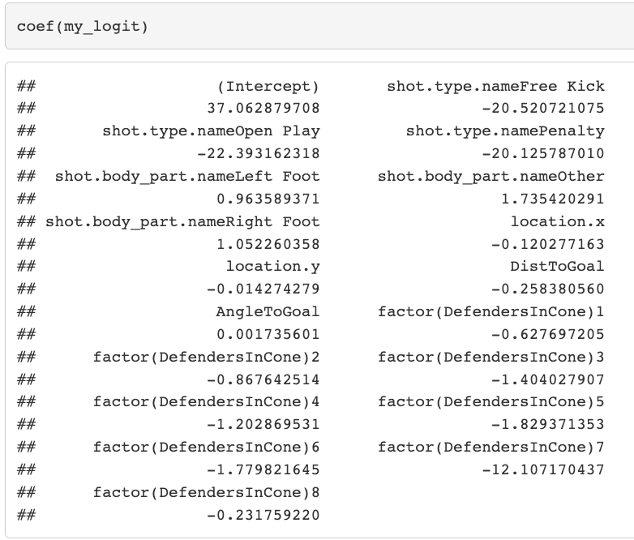
The original model and the model with team fixed effects have very similar coefficients
Addressing OVB
Notes:
The coefficients in both models are very similar to each other. Since fixed effect models allow us to control for variables that are constant over time, it seems that these variables are not important for the estimates we’re generating.

Slide 16
The orchestration of the offense is ideally controlled by your midfielders. The entire footballing world is seeing a revolution towards Johan Cruyff’s style of play. The tactical mastermind’s style hinged on successful passing.
In this day and age, the teams that pass more tend to have the best offenses.
Just take a look at the likes of Man City, Barcelona, Arsenal.
We built our xP model using world cup data, as the number of passes were enough to create an accurate model - unlike xG.
Expected Successful Passes

Slide 17
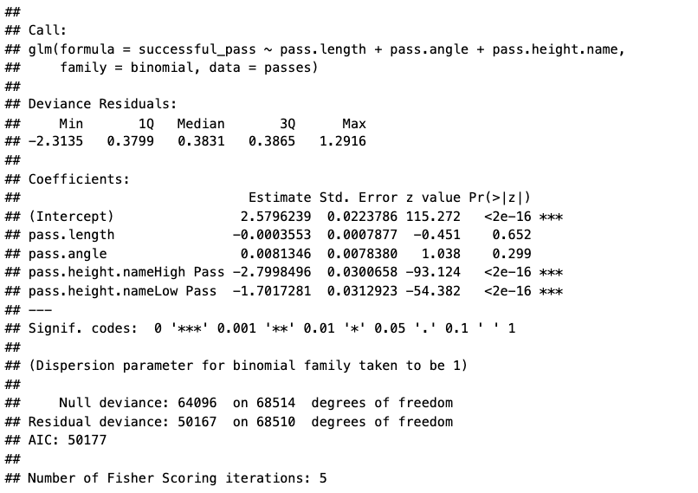
The xP Model

Slide 18
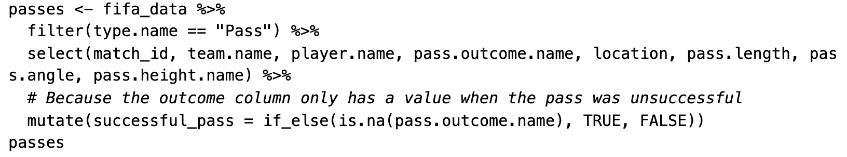
The variables we thought were important to include in our xP regression:
pass.length: the length of a pass in yards
pass.angle: the angle at which a pass is being given
pass.height.name: the height of the ball passes
Expected Successful Passes

Slide 19
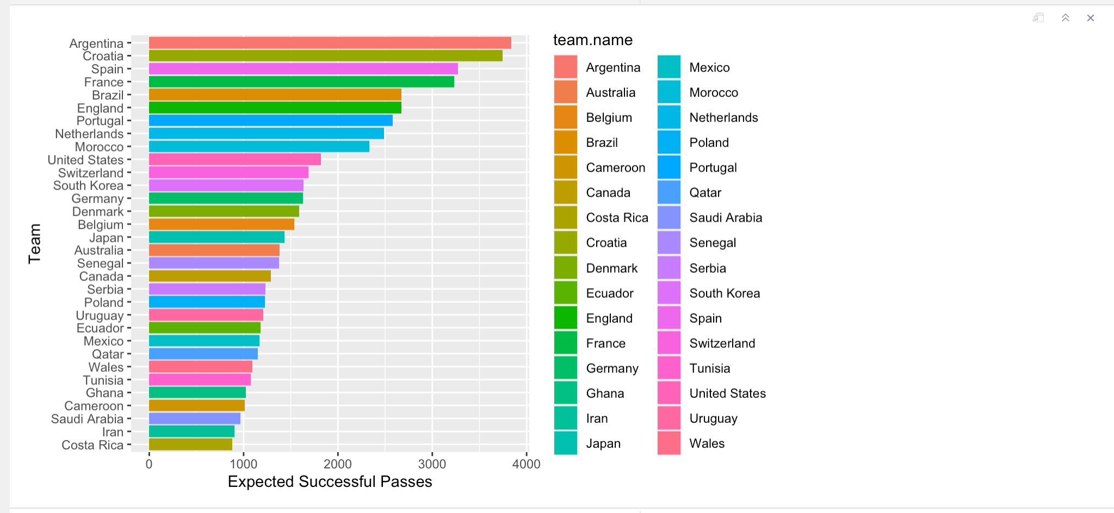
As mentioned, midfielders are important! Hence, the reason why Argentina and Croatia have the highest successful expected passes (elite players like Messi and Modric).
This midfielders deliver passes so beautifully that the angle, length, height etc. is perfect.
Expected Successful Passes

Slide 20
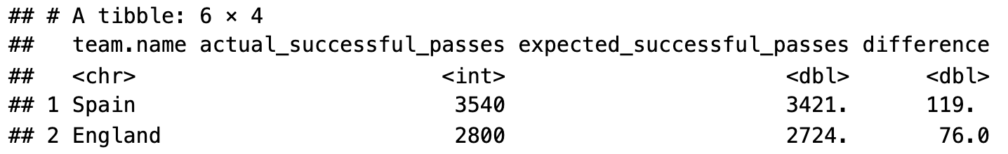
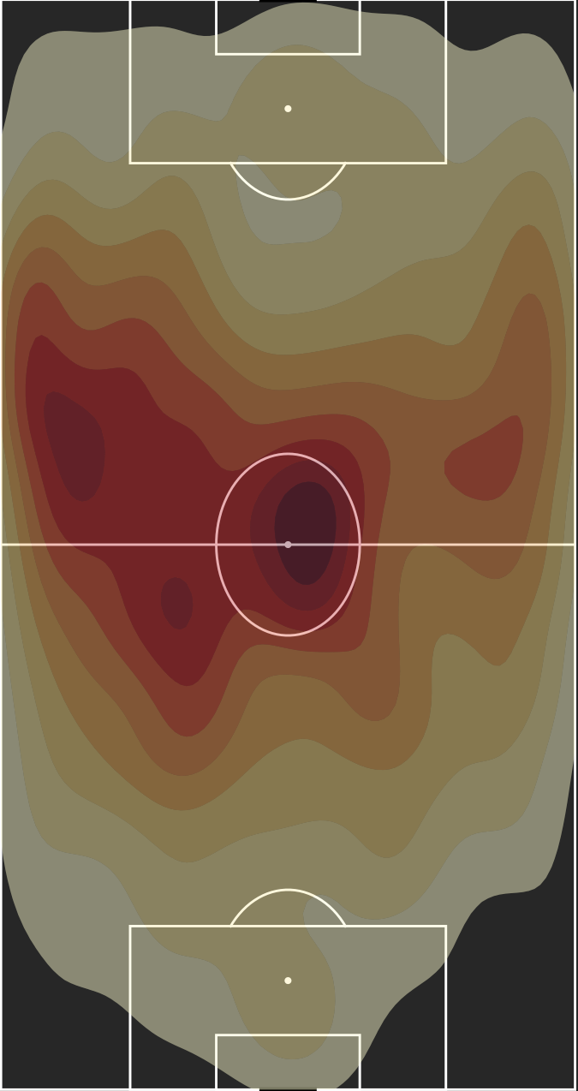
Spain has over performed the most when it comes to successful passing. They achieved 119 passes more than what was expected of them.
As seen in the heatmap, their passing is heavily concentrated in the midfield. This is also contributed by strikers on the left who drop back to receive passes.
Despite Spain having the high benchmark of third highest xP, they still managed to achieve the highest overperformance.
Spain Successful Passing Heatmap

Slide 21
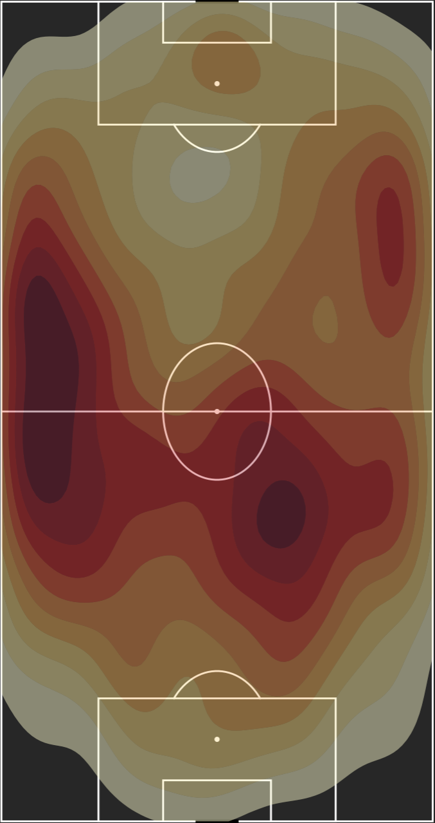
The second highest over performer is England. They have several hotspots of passing.
This makes sense as the Trent can be seen receiving the ball high up the pitch on the right side.
England could have also overperformed due to their strong midfield passers such as Bellingham, Rice, and Mount.
England Successful Passing Heatmap

Slide 22
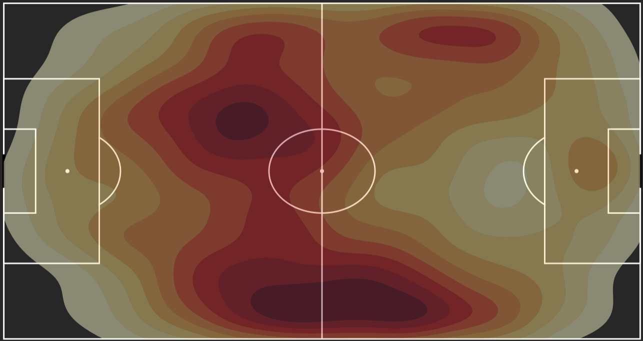
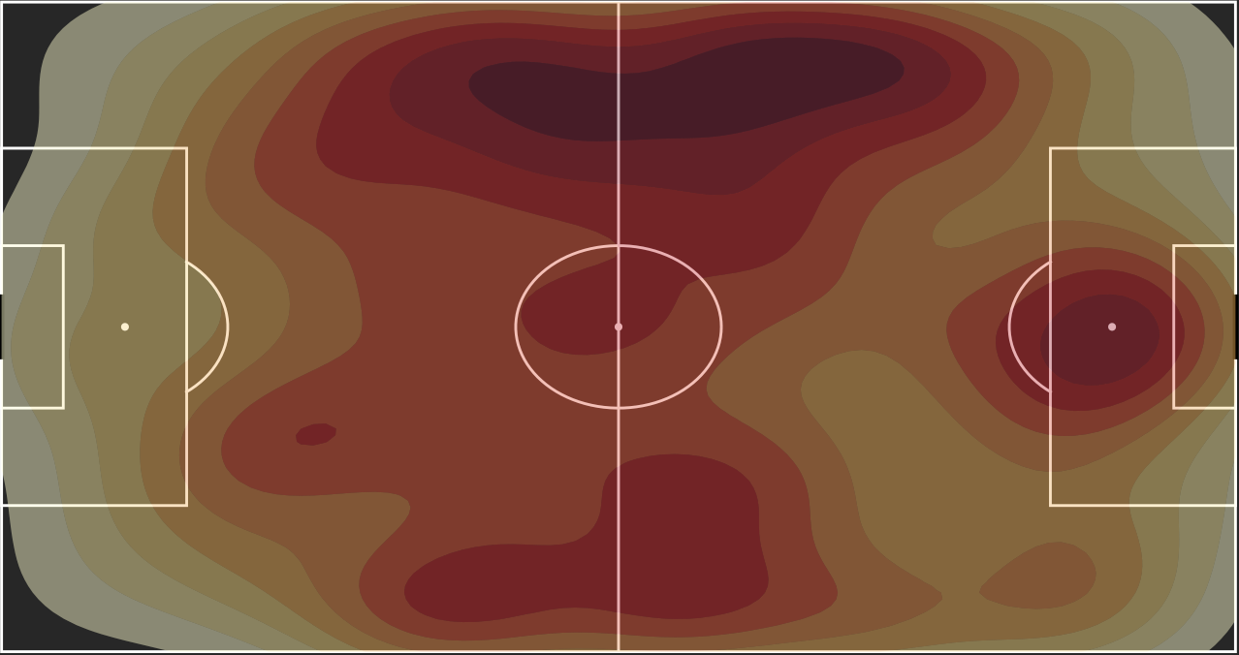
Japan Successful Passing Heatmap
Japan was the biggest passing underperformer at the World Cup. This means their goal-scoring carried them in the world cup - gaining some upsets such as their win against Spain and Germany.
Iran underperformed the most after Japan. This can be due to a number of reasons. Iran tends to underperform on the big stage despite their potential. It tends to happen at several competitions despite being ranked 20th in the world.
Iran Successful Passing Heatmap
xP Underperformers

Slide 23
xAG quantifies the probability of a pass that results in a shot (scoring chance) to be scored.
It investigates the contribution of an assist towards the likelihood of a goal being scored.
Through this model we gain a deeper understanding on the impact that each assist has in the game.
The same Premier League training data was used as our xG model to train the model.
Expected Assisted Goals (xAG)

Slide 24
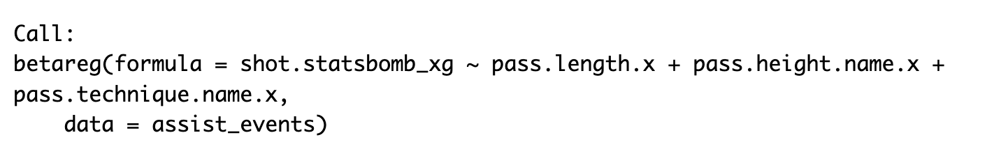
A beta regression was used for this model using the following coefficients:
pass.length: the length of the pass
pass.height.name: the height of the pass
pass.technique.name: Outswinging etc.
Expected Assisted Goals (xAG)

Slide 25
xG = Pass Length + Pass Height + Pass Technique
Expected Assisted Goals (xAG)
Quantitative Variable
Categorical Variables
Expected Goals for shots that come from passes

Slide 26
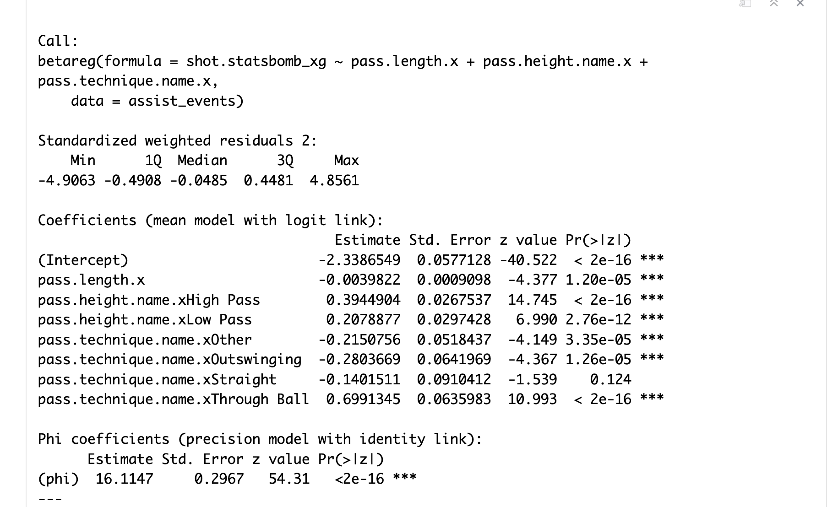
The xAG Model
Low p-value amongst variables

Slide 27
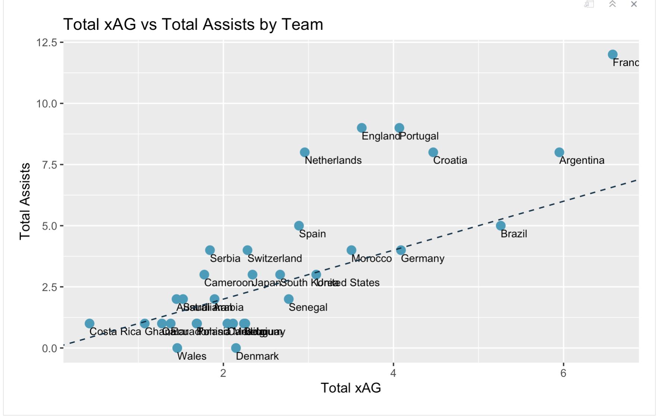
As can be seen in the chart on the right, the top two overperformers were France and England.
The most underperforming teams when it came to this metric were Denmark and Uruguay.
Expected Assisted Goals (xAG)

Slide 28
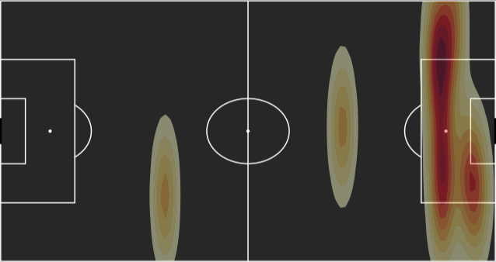
England’s assists are uniquely far away from the goalscorer. Observe assist from bottom left of the pitch. The model would have predicted these assists to diminish the outcome of a goal.
This gives us some extra context as to why England outperformed.
England Assists Heatmap
Expected Assisted Goals (xAG)

Slide 29
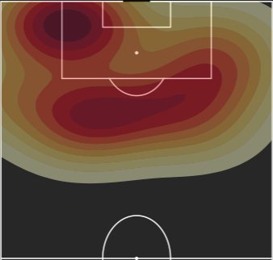
France’s actual assists were concentrated down the left hand side (guess who?).
Given pass length and the technique required from these locations (most likely outswinging, or inswinging), the negative coefficients may have driven the aggregate xAG down, resulting in overperformance.
France Assists Heatmap
Expected Assisted Goals (xAG)

Slide 30
In terms of expected goals, Argentina performed really well by their general play tactic and execution of goals. This can be explained by the amount of penalty kicks that Argentina received.
Moreover, the largest discrepancy between total goals and expected goals were noticed in Netherlands and Portugal.
This means that Netherlands and Portugal both played better than their expectations.
Conversely, Brazil under performed where they lined up a couple good goals but could not execute them well enough. Another example of this is Germany.
Conclusion

Slide 31
It is noticed that Argentina and Croatia have one of the best actual passes performance. This is proved by the fact that both of the teams have pretty good midfielders. Argentina has Messi and Croatia has Modric. These players are known worldwide for their exceptional performance. Spain overperformed the most as they had the largest discrepancy between successful actual and successful expected passes. This tells us that Spain played better than what the model expected them to.
Conversely, Costa Rica who performed the worst in terms of actual successful passes do not have good well known midfielders to make good plays and passes.
Conclusion

Slide 32
According to the expected successful assists model. It is evident that France and England had the best performance.
This is because their expected assisted goals and actual assists had the largest discrepancy indicating over performance.
This indicates good finishing in tough positions (open play) by clinical attacking players like Mbappe for France and Harry Kane for England, which gives players assists in positions where they are expected to not get assists.
Conclusion

